Slide 1
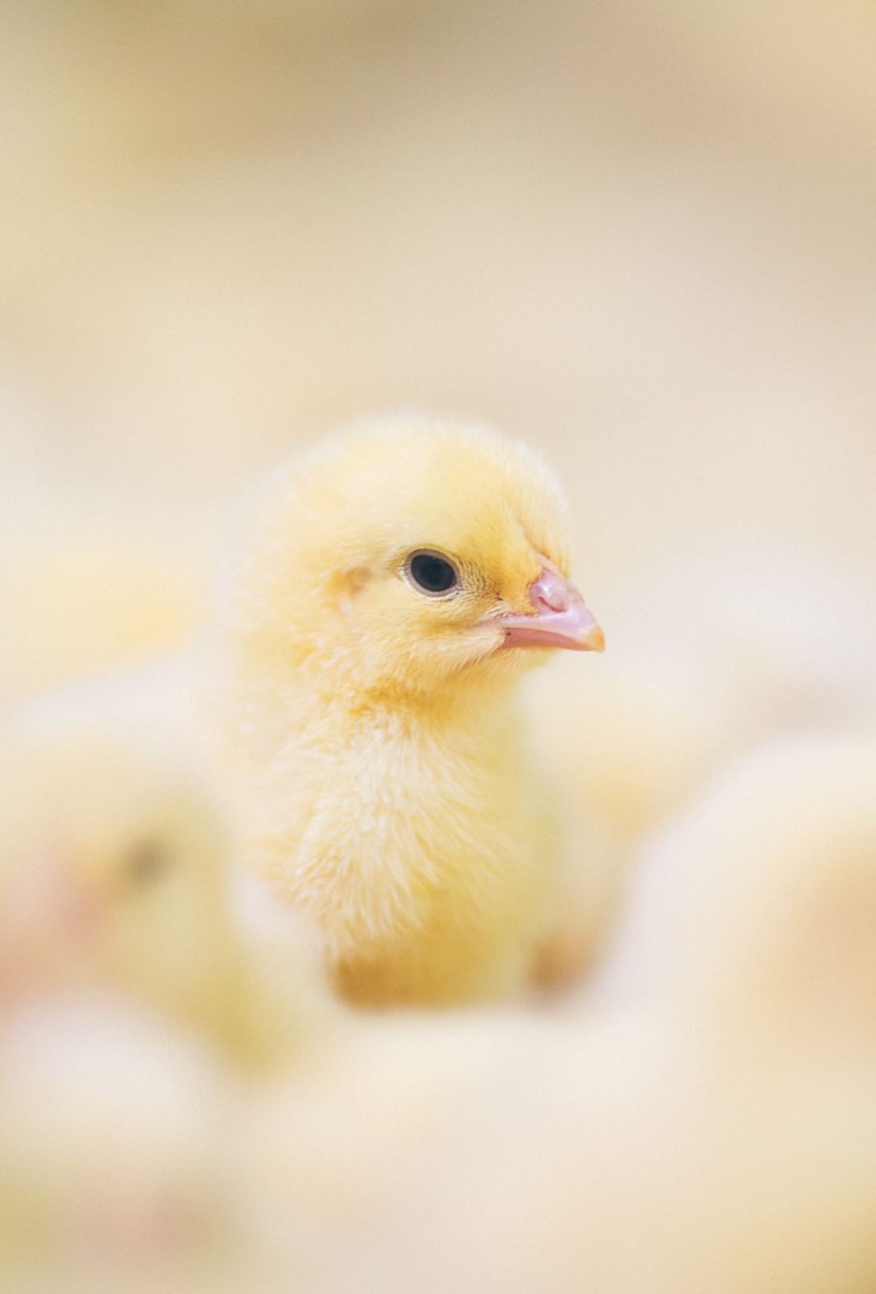
Poultry Farming Supply Chain
Blockchain Case Study
Rhythum, Rakesh, MOHIT, Sooda

Slide 2
Problem Definition
Solving Co-operatives failure rates by providing real time Co-op profiles to stake holders (rural development agencies)
Multiple rural development and value chain stakeholders will have the ability to monitor farmers’ production performance, target interventions at an early stage and facilitate trade
Co-operatives would be able to digitally co-ordinate their production cycles and act as a collective unit in the market.
Need
Farmers have limited knowledge in production practices
Solutions
to guide farmers in adopting prescribed production practices
to securely capture records at key stages of the Co-operative lifecycle
provide timely interventions
Advantage
Enable real-time access to stakeholders, process automation and traceability.

Slide 3
Local Vs Global Insights
Local Insights - Demonstrate
How Co-operatives can be collectively digitally presented
The commercial and technical feasibility of Co-operatives adopting these technologies
Global Insights – Demonstrate how
Co-operatives profile status can be tracked by multiple stakeholders in real-time
Process automation can improve communication and efficiency across multiple stakeholders
Co-operatives can securely engage with value chain partners over a digital platform

Slide 4
Co-op Life Cycle and Guidelines
Business Setup
Operations
Sales and Marketing
Ongoing Support
Stake Holder Functions
Co-op Profile Registration
KPIs
Accredidations
Monitoring & Intervnetions
Blockchain Functions

Slide 5

What do we solve?
Operational data ready on KPI - IoT, Analytics – underway
Piloted in an independent commercial farm
What aspects can be modelled by BC?
What blockchain models do we use?
Support from industry partner with data, input, feedback
Smart contracts for timely interventions
Tokenisation of incentives
Asset tracking (production) and incentives
Private, permissioned?

Slide 6
Further ideas Crypto in a Private Co-op System?
Rural development funding bodies have multiple signatures, multiple approvals involving transparency and traceability
Once approved, all parties have knowledge of the status
Standard rule creations out of inspections as a voting process
Smart contracts – automate the process for timely interventions
Is decentralisation required for triggering?
Do we need a BC based contract required? Will a flag do?
Combine multiple Co-ops – tie them to a BC for transparency from production to distribution
Finance tokenisation to incentivise farmers for best practices

Slide 7

Acknowledgement
Omnioyltics LTD – SA
Manav, Gushan, Akshay, Ahmed

